Slide 1


BANK LOAN ANALYTICS PROJECT
Presented by Group 3

Slide 2
INTRODUCTION
Project Overview
Bank Loan Analytics aims to analyze a bank’s loan portfolio and understand loan performance, customer behavior, repayment patterns, and credit risk.
Purpose
The main purpose of this project is to analyze bank loan data and identify meaningful patterns, trends, and risks that can help the bank improve its lending decisions.
Outcome
The project converts raw loan data into an interactive analytical dashboard that helps users understand the bank's loan portfolio.

Slide 3




TOOLS USED
Microsoft Excel
Power BI
SQL
Tableau

Slide 4

Business Objectives
Analyze Loan Applications
Measure Loan Amount & Funding
Monitor Loan Performance
Identify High-Risk Customers
Analyze Customer Segments
Evaluate Revenue & Interest
Improve Credit Risk Management

Slide 5
Data Sets
Key Columns:
id
loan_amnt
funded_amnt
int_rate
grade
annual_inc
loan_status
Purpose
issue_d
addr_state
dti
total_pymnt total_rec_prncp total_rec_int
recoveries
last_pymnt_d last_pymnt_amnt revol_bal
total_acc
last_credit_pull_d
Finance_1(Loan Data)
Dataset contains the basic loan application, borrower, and loan details.
Finance_2 (Customer & payment data)
Dataset contains additional information about loan payments, borrower credit history, and loan performance.

Slide 6
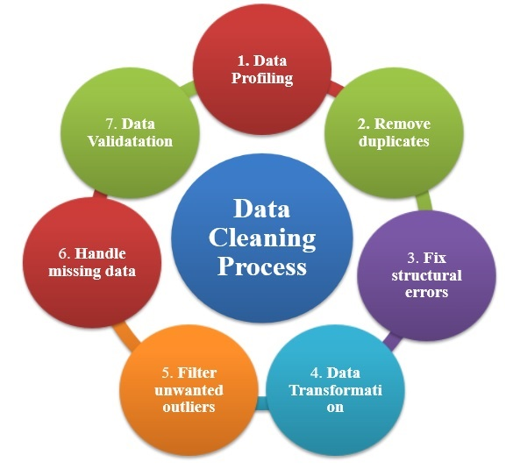
Data Cleaning
Import Finance_1 and Finance_2 datasets
Understand the structure and columns of both datasets
Clean duplicate and missing records
Correct data types for numerical and date fields
Convert issue_d, last_pymnt_d, and last_credit_pull_d into date format
Create Year and Month fields for time-based analysis
Validate common columns such as id
Merge both datasets using common keys such as id
Combine the required information from both datasets
Verify the final dataset for accuracy
Prepare clean data for analysis and dashboard creation

Slide 7
KPI’S Addressed
💰 Year wise loan amount Stats
💳 Grade and sub grade wise revol_bal
✅ Total Payment for Verified Status Vs Non Verified Status
📍 State wise and last_credit_pull_d wise loan status
🏠 Home ownership Vs last payment date stats

Slide 8
Our Findings
Total Customers
39,717
Total Loan Amount
446 M
Average Interest Rate
12.02%
Total Revolve Balance
531.5 M
Average DTI
13.32

Slide 9
KPI-1: Year wise loan amount Status
This chart shows the total loan amount issued each year from 2007 to 2011.
It shows a strong upward trend in loan amounts over the years.

Slide 10
KPI-2: Grade and sub grade wise revol_bal
This chart shows the revolving balance across different loan grades and sub-grades, from A1 to G5.
Grade B has the highest revolving balance, with B3 reaching 40, while the revolving balance generally decreases as we move toward the lower grades, especially F and G.

Slide 11
KPI-3: Total Payment for Verified Status Vs Non Verified Status
Verified: Shows the total amount paid by borrowers whose loan verification status is Verified.
Not Verified: Shows the total amount paid by borrowers whose verification status is Not Verified.

Slide 12
KPI-4: State wise and last_credit_pull_d wise loan status
This chart is used to understand how loan statuses are distributed across different states and over the latest credit-pull periods.

Slide 13
KPI-5: Home ownership Vs last payment date status
This analysis shows the relationship between a borrower's home ownership type and their last payment date/status.

Slide 14
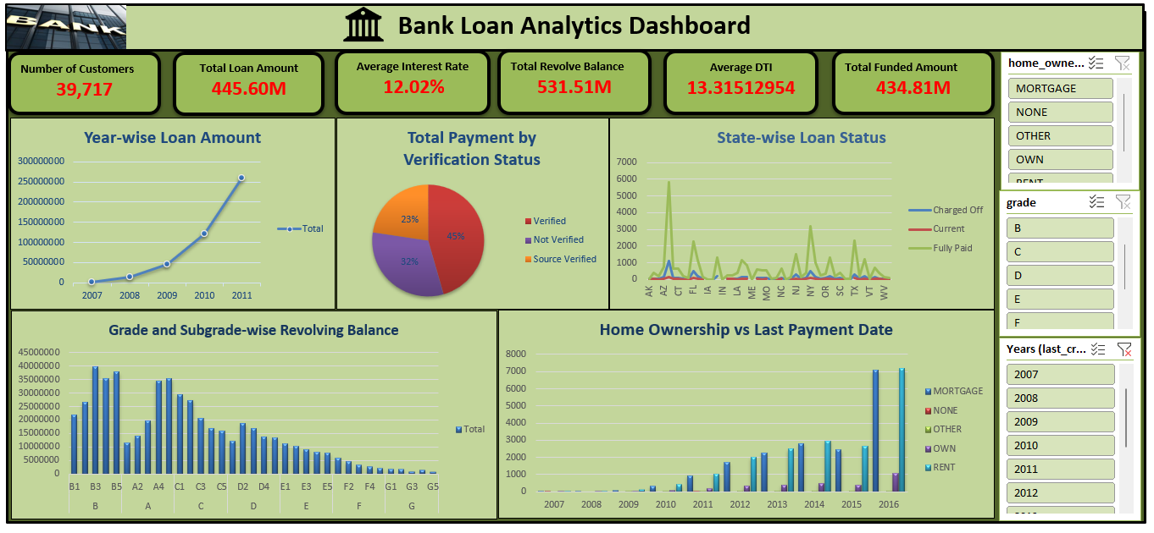
EXCEL Dashboard

Slide 15
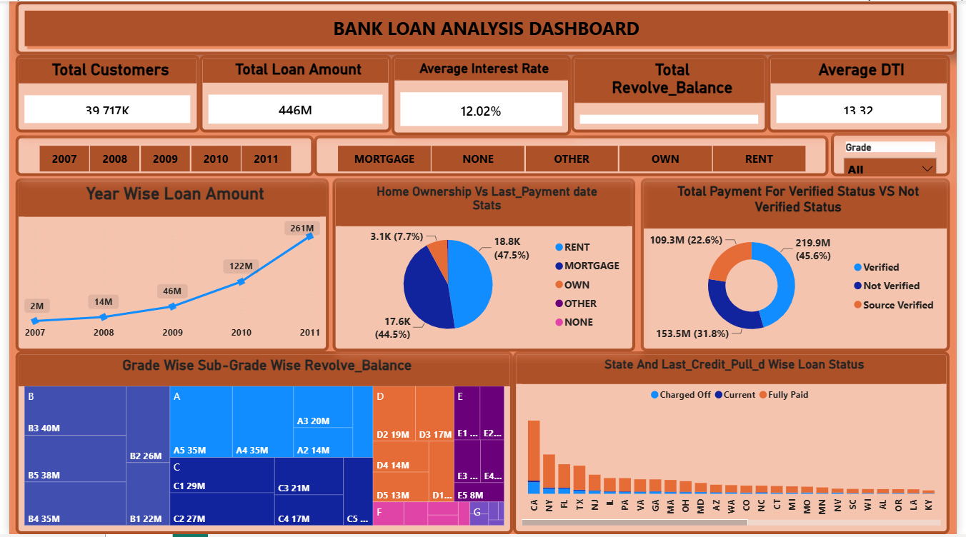
POWER BI Dashboard

Slide 16
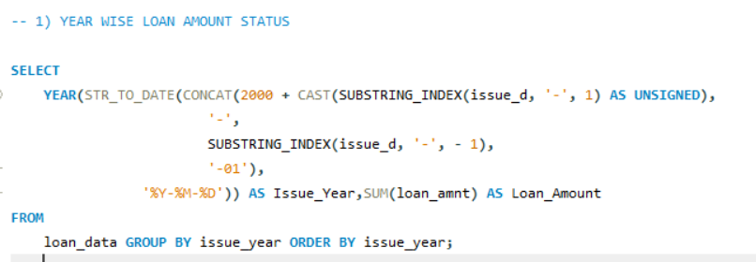
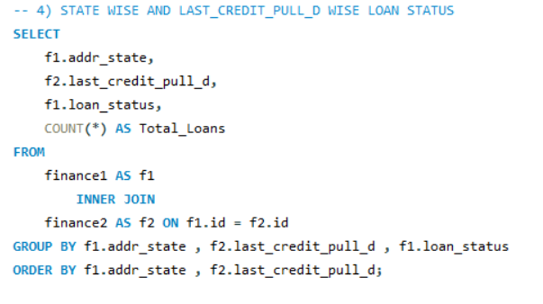
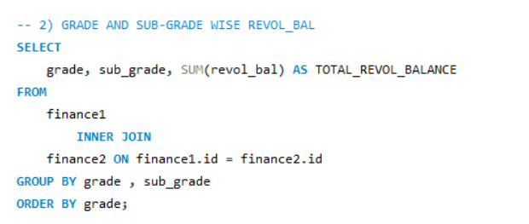
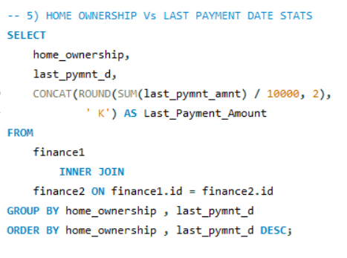
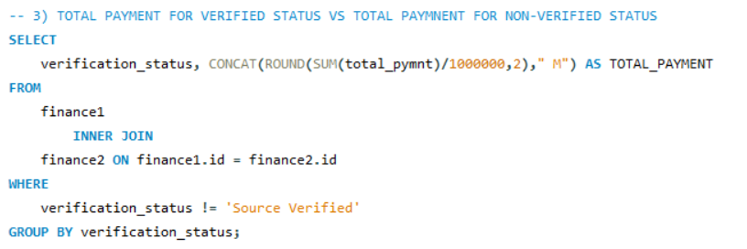
SQL Queries
KPI-4
KPI-1
KPI-2
KPI-5
KPI-3

Slide 17
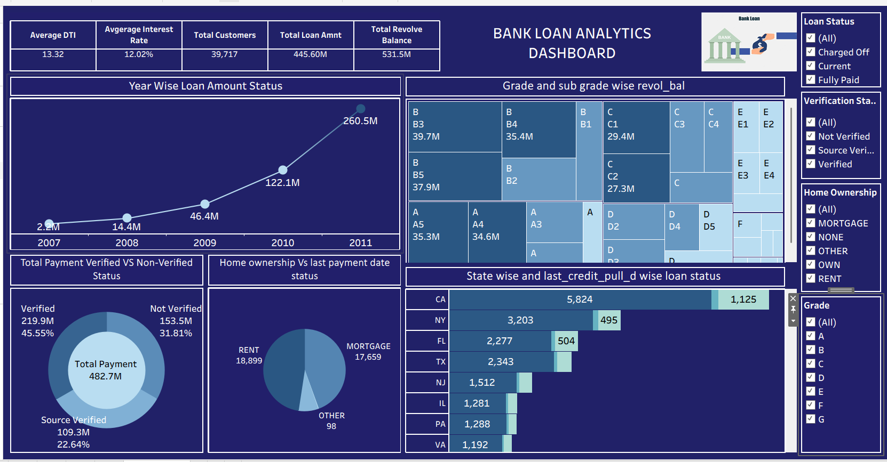
Tableau Dashboard

Slide 18


